Slide 1


Infosys Springboard VirtualInternship-2026 ELECTVIZ
ELECTION DATA VISUALIZATION FOR MEDIA
Mentor - Mrs. Nithyasree S J
Group- 1, Batch-11
Team C
Jyoti Pathak
Jasleen Kaur
Nikhitha
Bhavishya Priyadarshini V

Slide 2




1
PROJECT
To analyze Indian General Election data at a national level
DESCRIPTION
ElectViz is an interactive data visualization project developed using Power BI.
The project converts large and complex election datasets into interactive dashboards, making election insights easy to understand for analysts, media organizations, and the general public.
By simplifying raw data into visual stories, ElectViz supports fact-based, data-driven political analysis and helps users interpret election outcomes more effectively.
O
B
J
E
C
T
I
V
E
2
To visualize voting patterns, turnout, and party performance
3
To demonstrate how data analytics and visualization improve political reporting and decision-making
4
To study candidate participation, including gender analysis, regional analysis.

Slide 3
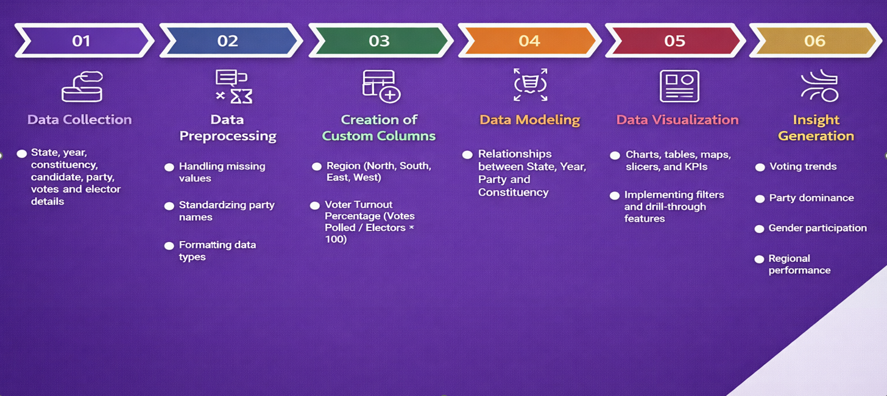
SYSTEM DESIGN AND
WORKFLOW

Slide 4
PROJECT EXECUTION
MILESTONES
Data Cleaning & Preprocessing
Initial Dashboard Development
Collected election data from Kaggle and cleaned it using Power BI.
Handled missing values, standardized state/party names, removed duplicates, and corrected data types.
Created 3 dashboards: Election Overview, Gender Analysis, and Regional Analysis.
Provided insights into votes, participation, and regional trends.
01
02
Core Visual & Trend Analysis
Advanced Insights And Performance Analysis
Developed dashboards for state-wise voting trends and candidate participation analysis.
03
Built dashboards for voter turnout comparison and top party performance analysis.
04

Slide 5


FACED
CHALLENGES
Large and complex dataset
Inconsistent and missing data
Performance issues in Power BI
Difficulty in presenting multi-dimensional insights
Overcrowded visuals
SOLUTIONS
Efficient data modeling
Data cleaning & preprocessing
Use of interactive slicers
Appropriate visualization selection
Dashboard structuring

Slide 6

KEY INSIGHTS
State-wise total votes distribution across election years
Gender composition of candidates contesting elections
Political parties participation overview
State-wise and Region-wise voter turnout trends over election years
Top-performing party by votes across state and year
Regional (North, South, East, West) party dominance analysis
Constituency reservation status distribution across states
Winning party and candidate details by state and year

Slide 7

FUTURE ENHANCEMENT
Integrate sentiment and public opinion data
Strengthen data validation & governance
Implement AI-driven insights
Demographic & Socio-economic indicators
Integrate real-time and post-election data

Slide 8

CONCLUSION
The ElectViz: Election Data Visualization for Media project successfully demonstrates how data analytics and visualization can convert complex election datasets into meaningful and actionable insights. By leveraging Power BI, the project transforms large-scale Indian election data into interactive dashboards that clearly present voting patterns, party performance, regional trends, and gender participation.
Overall, ElectViz enhances political reporting by enabling fact-based storytelling and informed interpretation of election outcomes. The project proves that interactive data visualization is a powerful tool for media organizations, analysts, and the public, and it lays a strong foundation for future extensions such as real-time election tracking and predictive analysis.

Slide 9
ACKNOWLEDGEMENT
We would like to express our sincere gratitude to:
Infosys Springboard Team for organizing this valuable virtual internship opportunity
Our Mentor for continuous guidance, constructive feedback, and support
My Teammates for their collaboration, encouragement, and shared insights
This internship has been a meaningful step in enhancing our professional growth and technical expertise.
REFERENCES
Election Dataset – Kaggle
Microsoft Power BI Official Documentation
Infosys Springboard Virtual Internship Course Materials

Slide 10

THANK YOU

